Slide 1

TSETSE AND TRYPANOSOMOSIS CONTROL ACTIVITIES IN xxxxxxx
2023 - 2025
Presenter:
Date:

Slide 2
Current Tsetse and Trypanosomiasis (T&T) situation in the DRC
(2023-2025)
.. | Province | Animal | Sensibles | Cas
1 | Haut-Katanga | Bovin | … | 218
 | Haut-Uélé | Bovin | …
2 | Ituri | Bovin | 1013 | 327
3 | Kinshasa-rural | Bovin, porcin | … | 255
4 | Kongo-Central | Bovin | … | 236
5 | Mai-Ndombe | Bovin | … | 417
6 | Mongala | Bovin |  | 216
7 | Nord-Kivu | Bovin, porcin | 243 | 62
9 | Sud-Kivu | Bovin, caprin | … | 102
10 | Sud-Ubangi | Bovin | … | 299
11 | Tanganyika | Bovin | … | 177

Slide 3
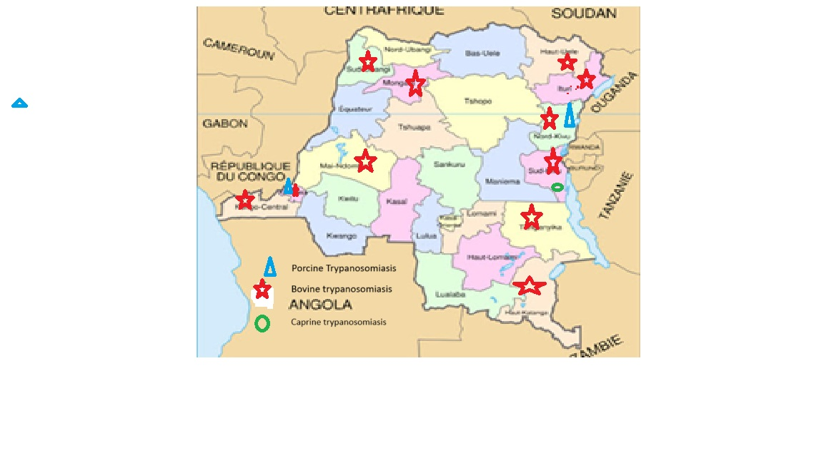
Current Tsetse and Trypanosomiasis (T&T) situation in the DRC
Infested provinces with animal trypanosomiasis
Distribution of animal trypanosomiasis
in the DRC from 2023 to 2025
11 Provinces infested with bovine
trypanosomiasis represented
by the red star
2 Provinces (North-Kivu, Kinshasa):
Porcine trypanosomiasis
represented by the blue triangle
1 Province (South-Kivu) : Caprine
trypanosomiasis represented by the
green circle

Slide 4
DISTRIBUTION OF TSETSE IN THE DRC
Province | Locality | Animal | Vector | Parasite
Maï-Ndombe | Mushie | Bovin N’dama | G. Tabaniformis | T. vivax T.congolense T.brucei brucei
Kinshasa | Hinterland | porcin | G. fuscipes quanzensis | T. simiae, T. vivax, T. congolense, T. brucei brucei T. brucei gambiense
Kongo-Central | Kimpika, Kasangulu, Kimpungi and Sanda | caprin | Glossina palpalis palpali | T. congolense, T. vivax T. brucei brucei
Kongo-Central | Kimpese |  | Glossina palpalis palpalis | T. congolense Savannah, T. brucei, T. congolense Forest T. vivax .
Maï-Ndombe | Mushie |  | G. tabaniformis
Kwilu | Idiofa |  | G. tabaniformis

Slide 5
Parasites diagnosis by national laboratories
1) Laboratoire Vétérinaire Central de Kinshasa
2023 : 26 suspected cases of animal trypanosomiasis
6 confirmed by the laboratory
2024 : 44 suspected cases of animal trypanosomiasis
1 confirmed by the laboratory
2) Laboratoire Vétérinaire de Goma (LVG)
2022 : 2 suspected cases of animal trypanosomiasis
2 confirmed by the laboratory

Slide 6
Tsetse and trypanosomiasis control and elimination activities undertaken in 2023-2025
T&T control and elimination activities undertaken over the last 2 years (2023-2025)
- There is no Government control program
Each farmer organizes to control the disease.
- In the East of the country, medicines are used to prevent and treat.
The drug trypamidium is used for prevention while diminazene aceturate is used for treatment.
Tsetse fly control is achieved using insecticide-impregnated fabric screens.

Slide 7
Tsetse and trypanosomiasis control and elimination activities undertaken in 2023-2025
In the west of the country, in Kongo-Central and Maï-Ndombe,
in addition to preventive and curative medications and vector control using insecticide-impregnated fabric screen traps,
the use of the Ndama breed, due to its tolerance to trypanosomiasis, is an important strategy.
Ndama is the main breed of cattle used by the SOGENAC company in Mushie (Maï-Ndombe Province) and Kolo (Kongo-Central Province).

Slide 8
Tsetse and trypanosomiasis control and elimination activities undertaken in 2023-2025
Veterinarans and veterinary paraprofessionals are sensitizing livestock
farmers about clearing trees around watering points, night kraals and
teatment corridors

Slide 9
Collaborations and partnerships for T&T control and elimination activities undertaken in 2023-2025
Partners/stakeholders and activities
- No partners supporting the fight against
- The disease is present but it has been underreported since the
2020s.
The reason for this underreporting :
the disease is not is not a priority in the DRC.
Yet it reduces productivity and accounts for approximately 13 % of
mortality cases at SOGENAC’s Mushie ranch in the west of the
country.
Crossborder/regional activities animal trypanosomiasis
No crossborder/regional activities animal trypanosomiasis

Slide 10
Challenges and how they are being resolved
Lack of Government subsidies and /or operanting funds
Difficulties in procuring sampling materials (consumables) and reagents
Lack of maintenance services for laboratory equipment, support from partners
No payment of most of the staff assigned to new units
Need to build the capacity of technicians in various laboratory diagnostic techniques, to ensure adequate refresher training

Slide 11
Way forward and planned T&T control and elimination activities for 2025-2027
Planned activities for the next 2 years
- Development of an animal trypanosomiasis control plan
- Implementation of this plan
- Stakeholders awareness
- Capacity building for field stakeholders
- Capacity building for national laboratories in trypanosomiasis
diagnosis
- Vector control

Slide 12


