Slide 1

TSETSE AND TRYPANOSOMOSIS CONTROL ACTIVITIES IN CAMEROON
2023 - 2025
Presenter: Samuel ABAH, PhD
15 September 2025

Slide 2
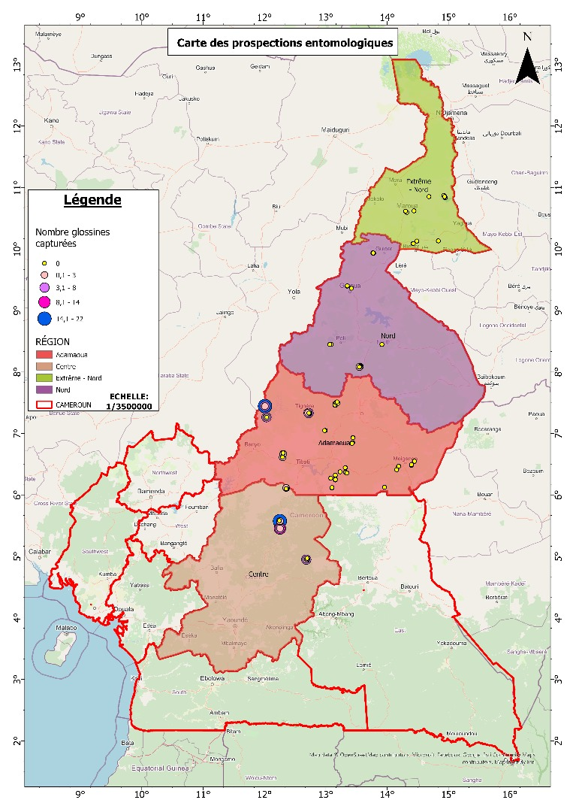
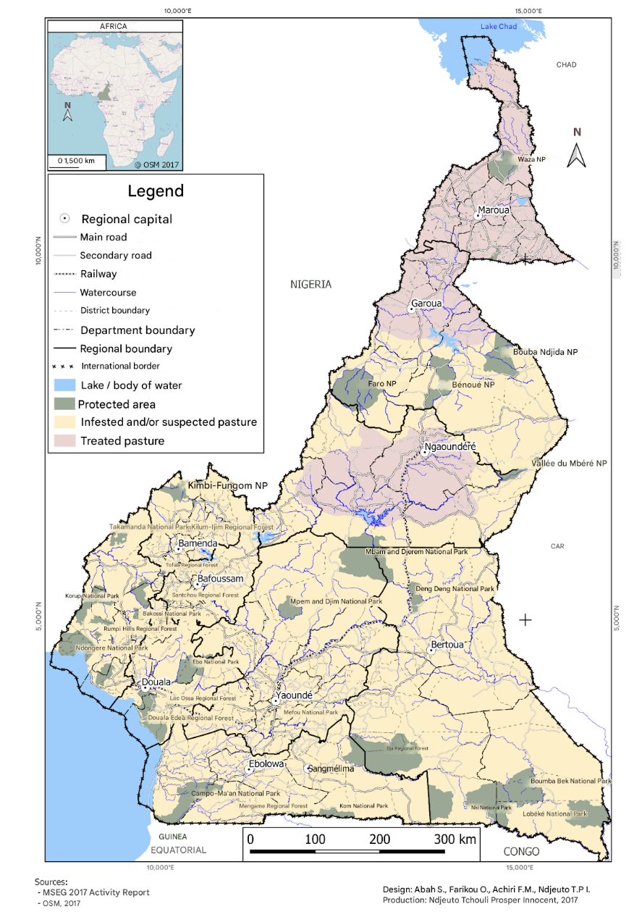
Current Tsetse and Trypanosomiasis (T&T) situation
Areas infested
Areas under control and elimination activities

Slide 3
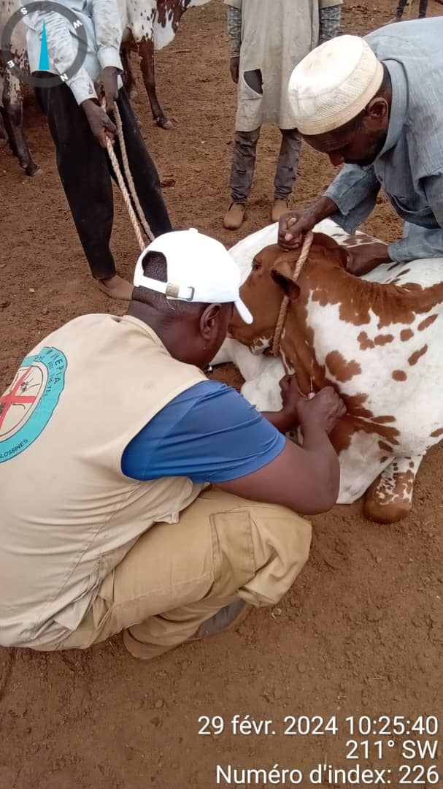
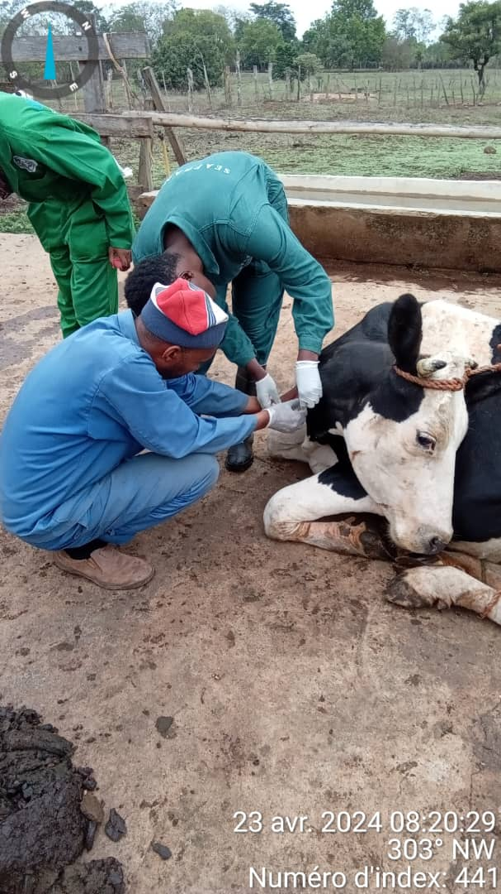
Tsetse and trypanosomiasis control and elimination activities undertaken in 2023-2025
T&T control and elimination activities undertaken over the last 2 years (2023-2025)
Parasitological Surveys
• Blood sampling conducted in dairy farms.
• High seroprevalence: 75%.
• Confirms active parasite circulation.

Slide 4
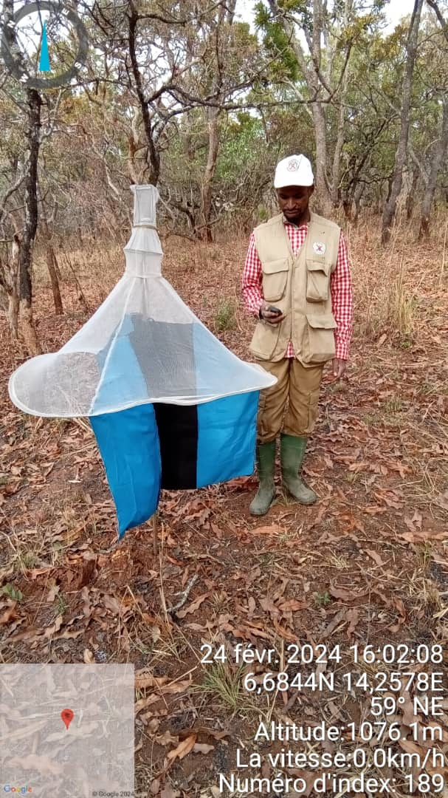
Tsetse and trypanosomiasis control and elimination activities undertaken in 2023-2025
T&T control and elimination activities undertaken over the last 2 years (2023-2025)
Entomological Surveys
• Thousands of vectors captured (Glossina, Stomoxes, Tabanides).
• 252 tsetse flies (mainly Glossina tachinoides).
• Significant populations of tabanids and stomoxes.
• Identified hotspots for intervention.

Slide 5
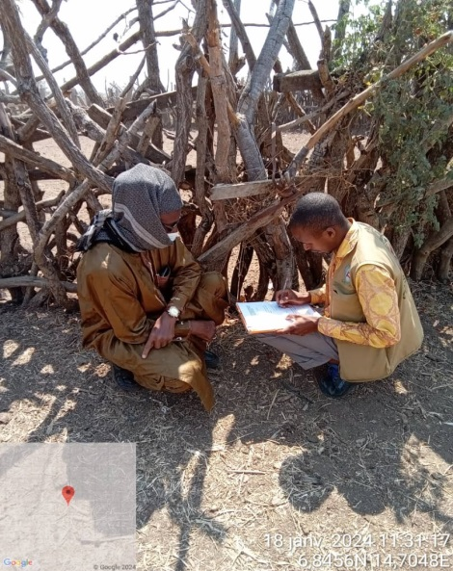
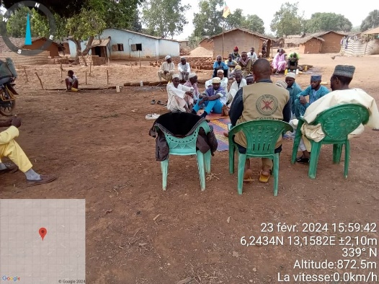
Tsetse and trypanosomiasis control and elimination activities undertaken in 2023-2025
T&T control and elimination activities undertaken over the last 2 years (2023-2025)
Socio-economic Surveys
59.29% of cattle herds affected by AAT.
AAT as one of the most pressing animal health challenges.
Over 60% of households reported income losses.

Slide 6
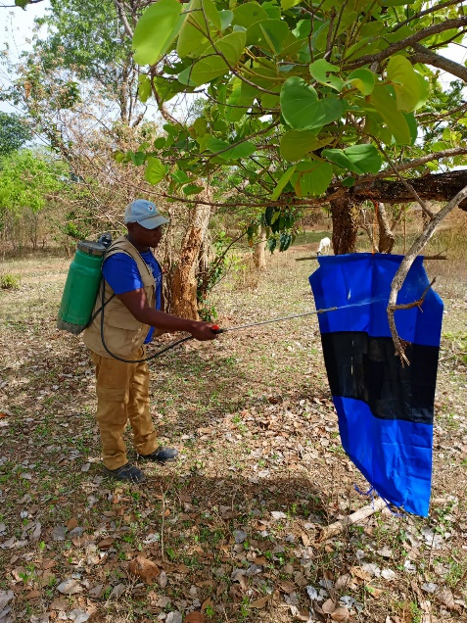
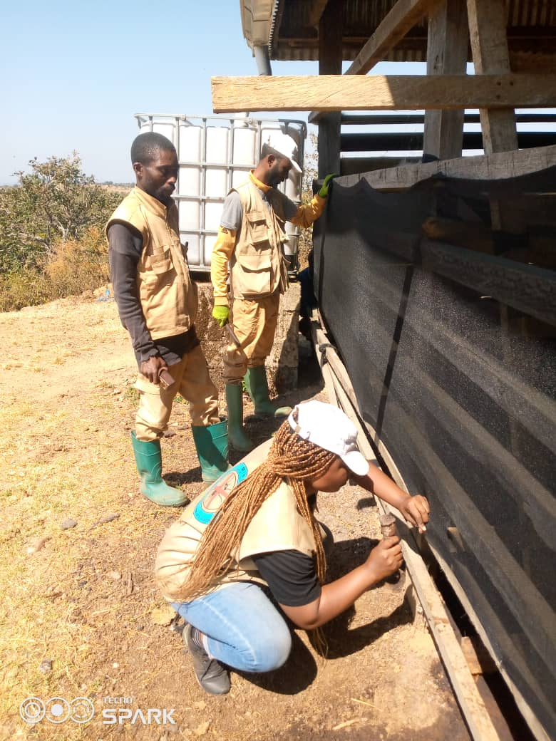
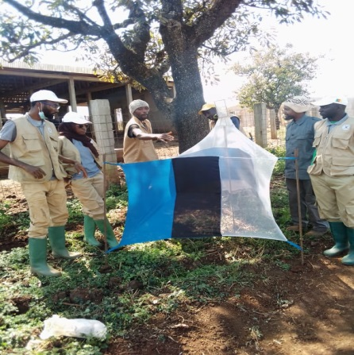
Tsetse and trypanosomiasis control and elimination activities undertaken in 2023-2025
T&T control and elimination activities undertaken over the last 2 years (2023-2025)
Vector control
• 70 livestock fences.
• 270 control traps.
• 2,700 impregnated screens deployed.
• Epicutaneous treatment of 9,200 cattle

Slide 7
Collaborations and partnerships for T&T control and elimination activities undertaken in 2023-2025
- DVO/RESCAM -CEBEVIRAH
-LANAVET -COMBAT Consurtium
- ZOONOTIC program
-University of Dschang and Ngaoundere
-PNLTHA programm

Slide 8
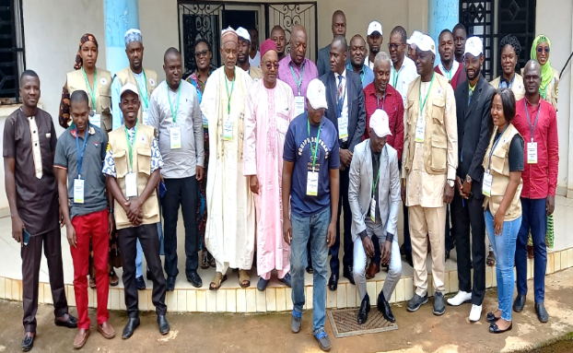
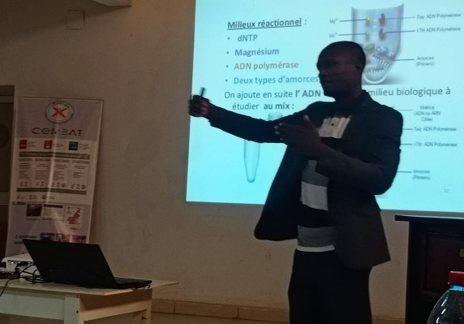
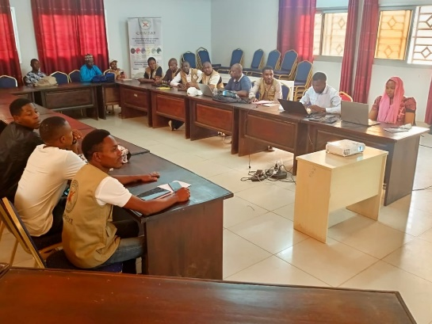
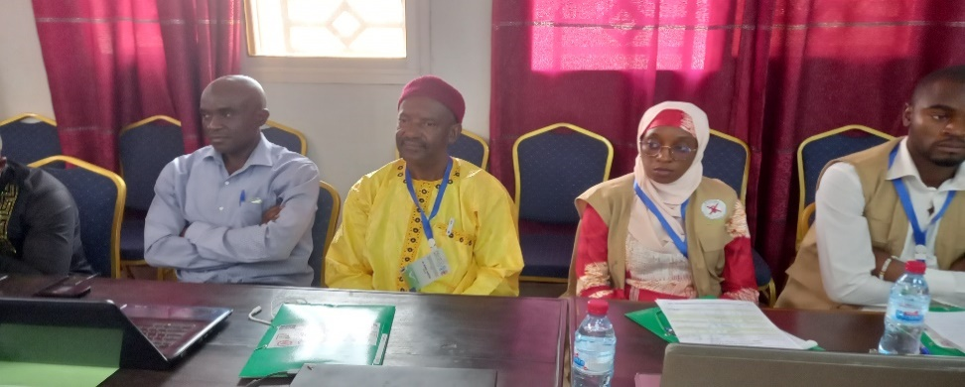
Collaborations and partnerships for T&T control and elimination activities undertaken in 2023-2025
Partners/stakeholders and activities
Training and Internship
MSEG staff
DVM, MSc and PhD students on academic placements
Breeders and professionals

Slide 9
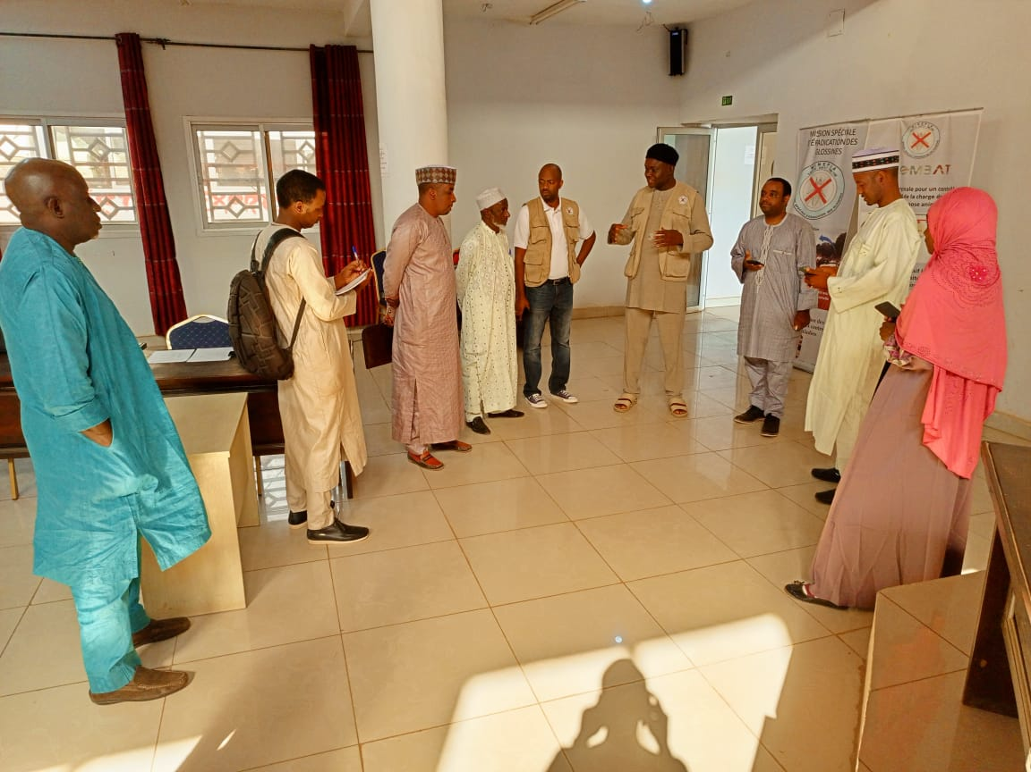
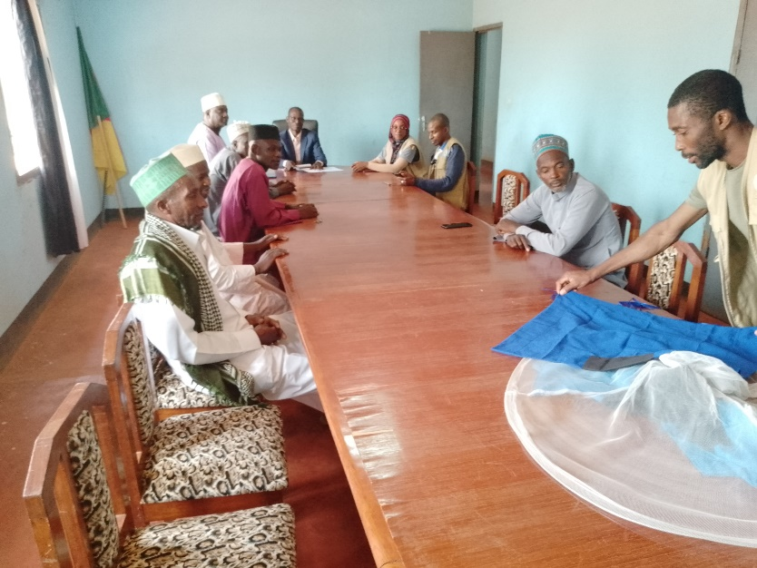
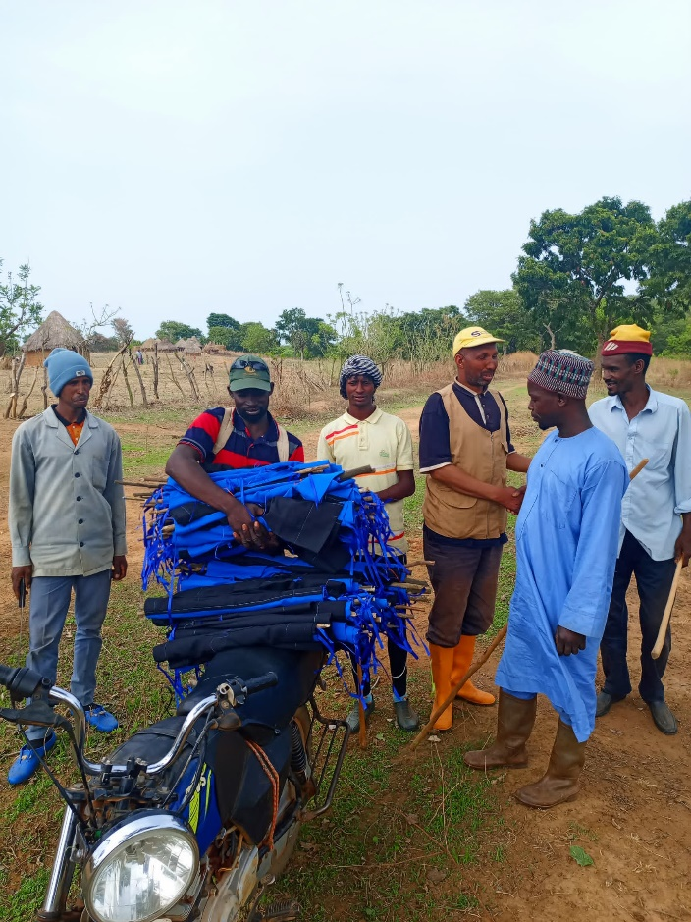
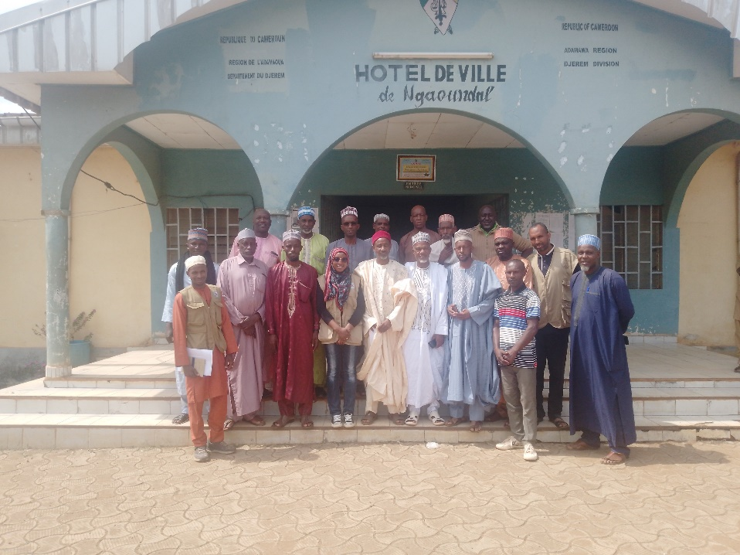
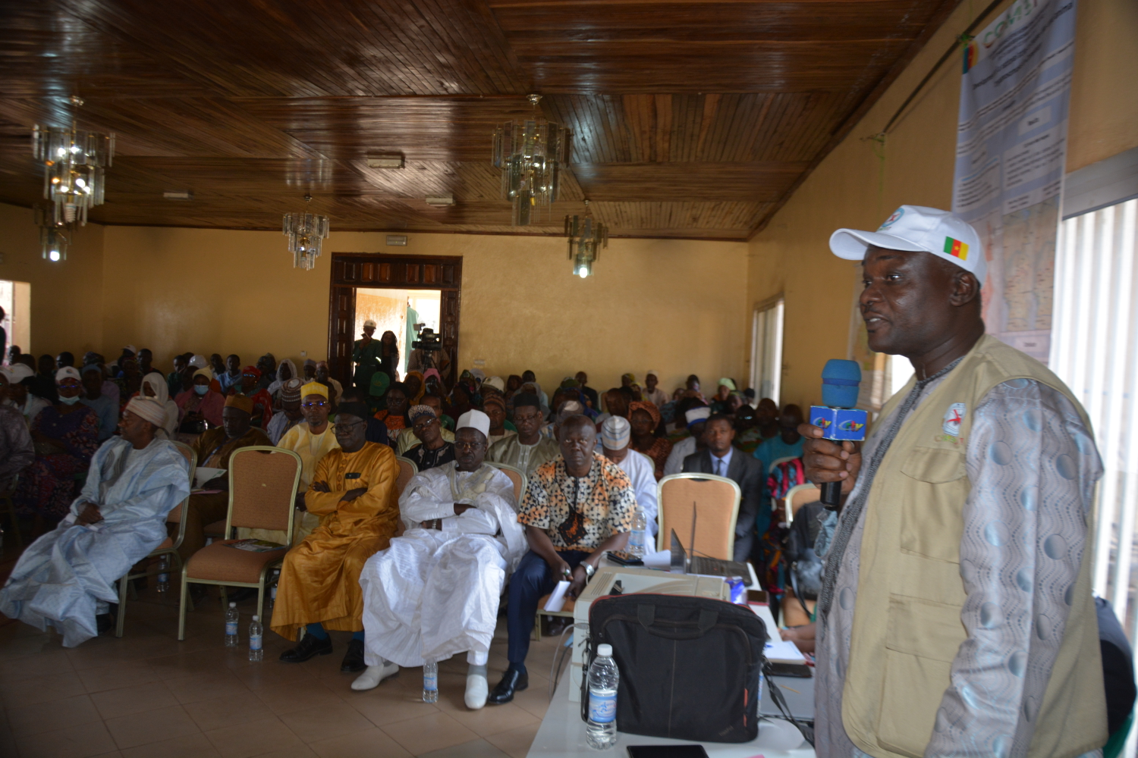
Collaborations and partnerships for T&T control and elimination activities undertaken in 2023-2025
Raising awareness
Partners/stakeholders and activities
• 4,500 stakeholders sensitized (farmers, technicians, local authorities).

Slide 10
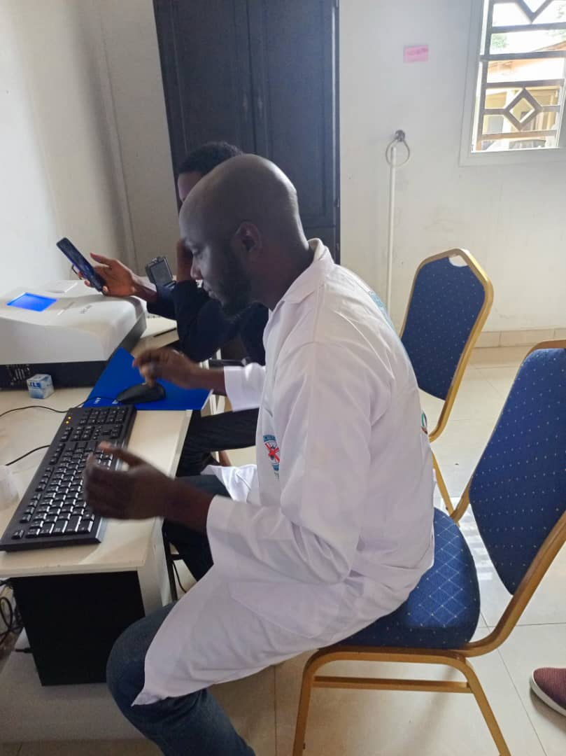
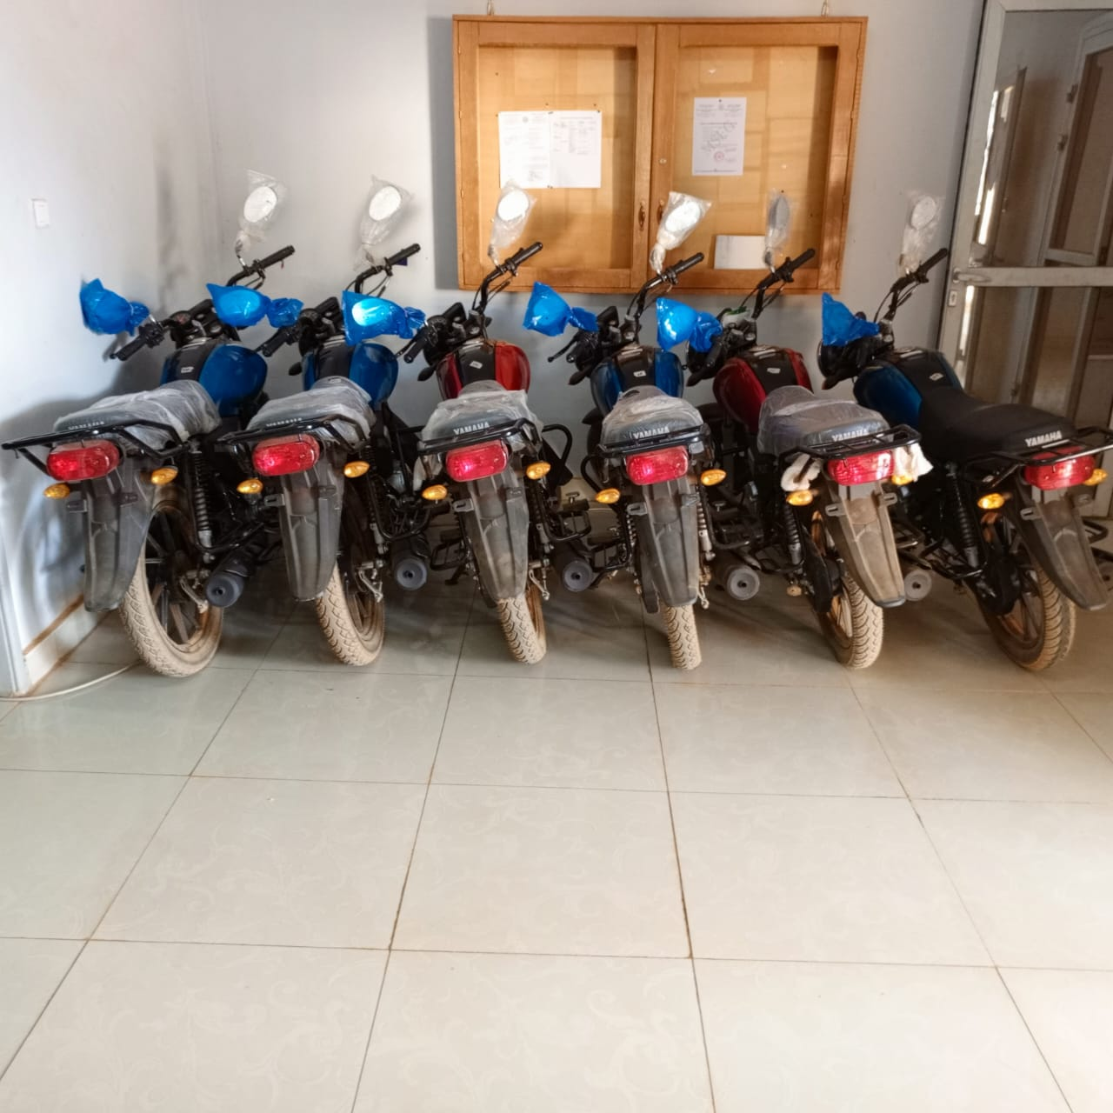
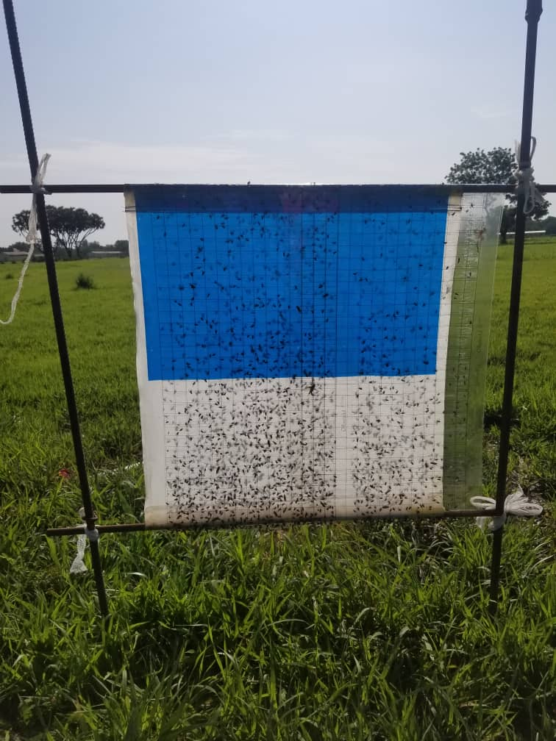
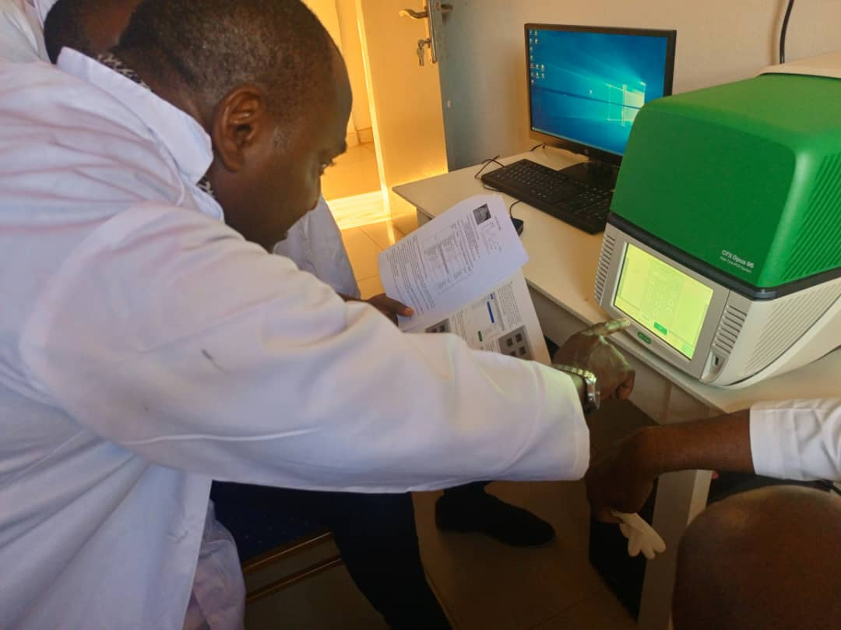
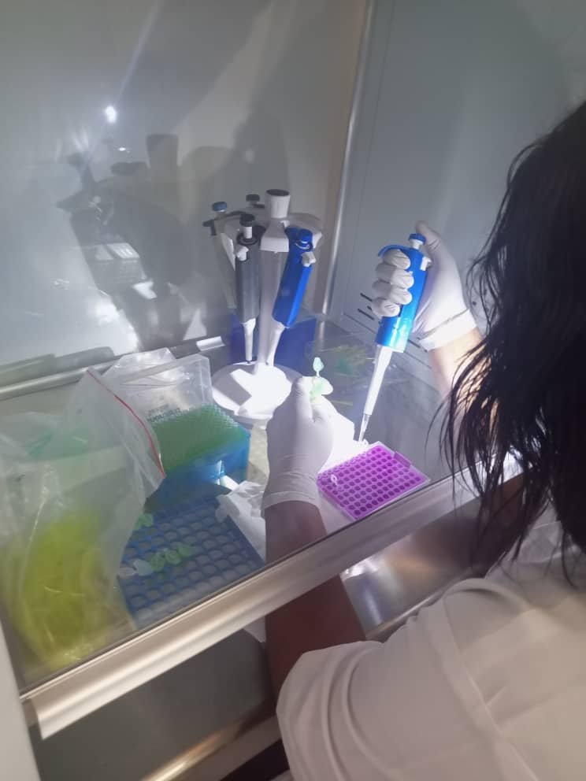
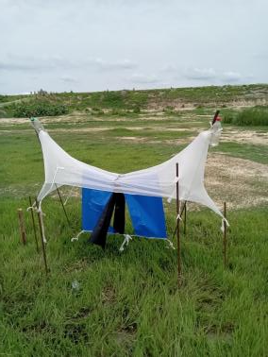
Collaborations and partnerships for T&T control and elimination activities undertaken in 2023-2025
Partners/stakeholders and activities
COMBAT Project
Capacity building
Strengthening mobility, data collection and diagnostic capabilities.
Database and atlas

Slide 11
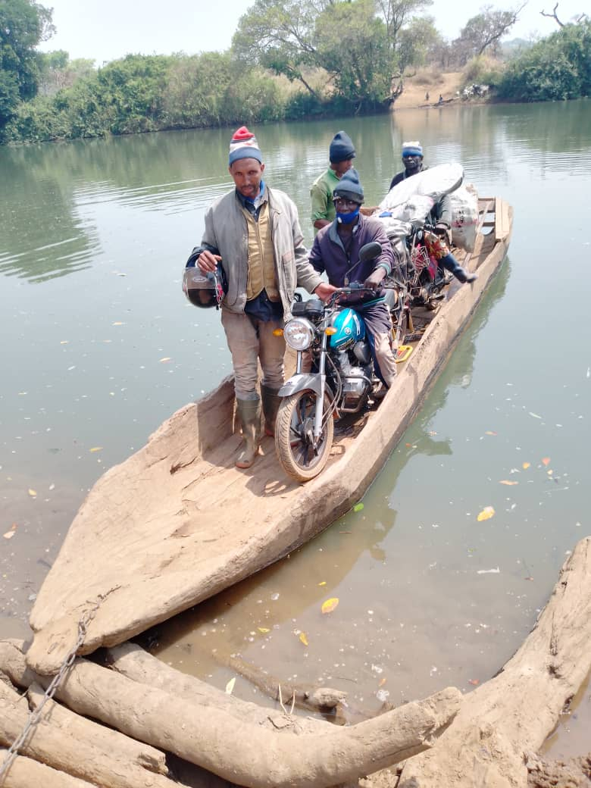
Challenges and how they are being resolved
1. Climatic variability : Seasonal changes.
Resolution: MSEG integrates climate data into planning, adjusts the timing of interventions to seasonal patterns, and strengthens continuous surveillance to anticipate outbreaks.
2. Accessibility of certain areas : Remote and insecure zones.
Resolution: MSEG collaborates with local communities and livestock associations to decentralize activities, relies on community-based vector control committees, and uses mobile teams equipped with GPS and motorcycles for hard-to-reach areas.

Slide 12
Challenges and how they are being resolved
3. Sustainability of interventions : Maintaining vector control structures (screens, traps) and continuous farmer engagement requires long-term resources.
Resolution: Stronger partnerships with livestock keepers, training of para-veterinarians, and integration of trypanosomiasis control into national animal health strategies ensure ownership and durability.

Slide 13
Way forward and planned T&T control and elimination activities for 2025-2027
Planned activities for the next 2 years
  The MSEG proposes to:
consolidate its achievements and intensify its activities for the period 2025-2027, with the aim of achieving greater national geographical coverage.
mobilize other sources of funding through development donors and private organizations.
adopt multisectoral approaches and strengthen sub-regional cooperation.
effectively implement the ‘One Health’ approach.

Slide 14


