Slide 1

TSETSE AND TRYPANOSOMOSIS CONTROL ACTIVITIES IN BURKINA FASO
2023 - 2025
Presenter: Dr Soumaïla PAGABELEGEUM
Date: 15/09/2025

Slide 2
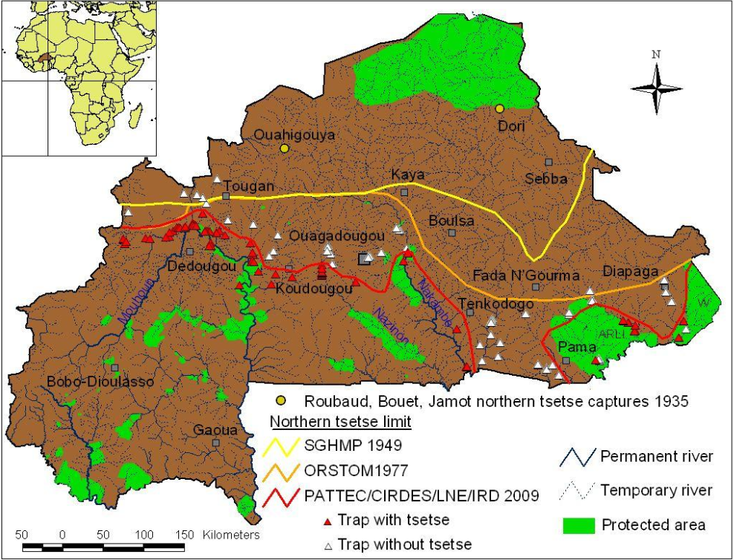
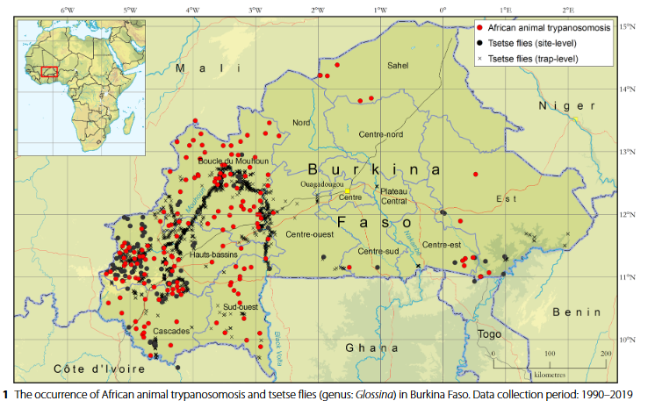
Current Tsetse and Trypanosomiasis (T&T) situation
Tsetse infested area : ~ 45% Burkina
AAT infested area : almost all Burkina
Courtin et al., 2010
Percoma et al., 2022

Slide 3
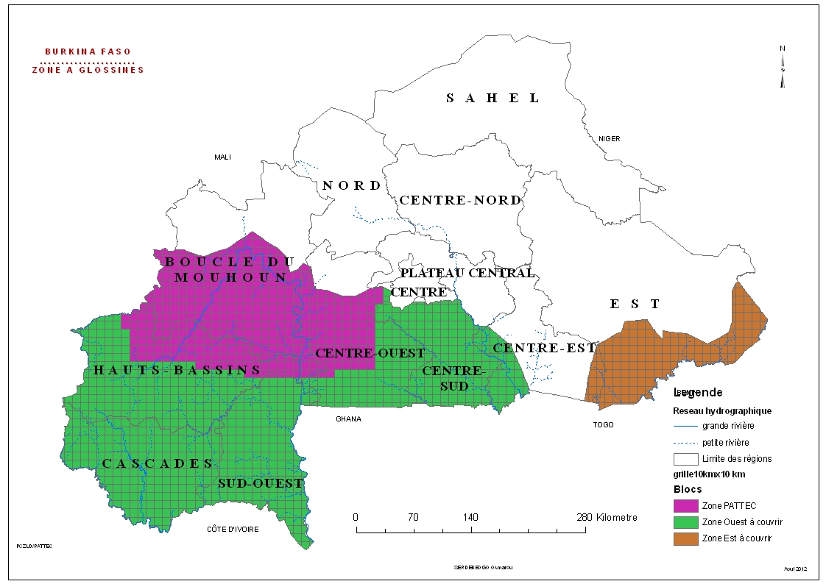
Current Tsetse and Trypanosomiasis (T&T) situation
Areas under control and elimination activities
PATTEC initiative (2006-2013)
Percoma et al. 2018
Tsetse control: 95% reduction of tsetse densities over 40 000 km²
AAT prevalence underscored: 90% (from 3.29 to 0.31)
Build a regional Tsetse insectarium (IBD)
COMBAT activities: densities remain low

Slide 4
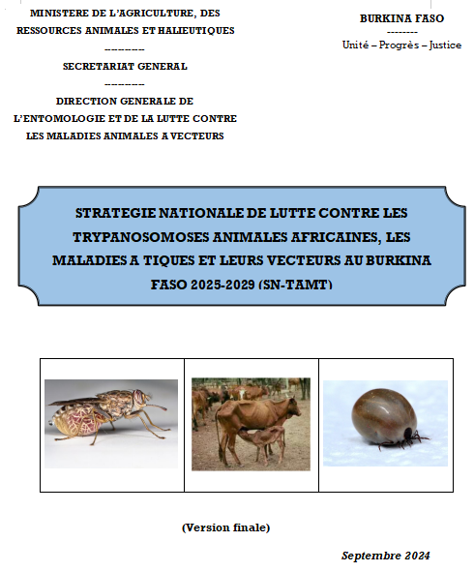
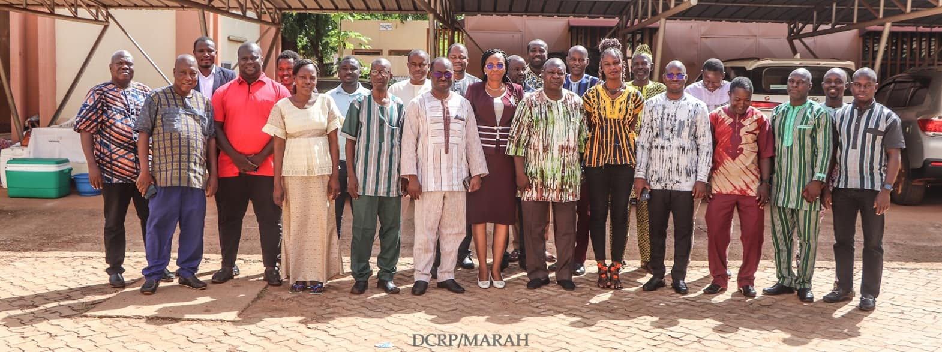
Tsetse and trypanosomiasis control and elimination activities undertaken in 2023-2025
Insectarium of Bobo-Dioulasso (IBD):
  mass rearing of G. p. gambiensis to support Senegal eradication project
  IBD is an IAEA Collaborating Centre (2021-2025) for the mass-rearing of sterile males and for
  supporting countries in implementing the SIT and is currently being renewed for 2026-2030
Updating the ATLAS for tsetse and AAT with COMBAT: Percoma’s presentation
Mapping the PCP for AAT in Burkina: Poster session
Developing a national strategy and action plan to control
AAT, Ticks borne-diseases and its vectors, in 2024

Slide 5
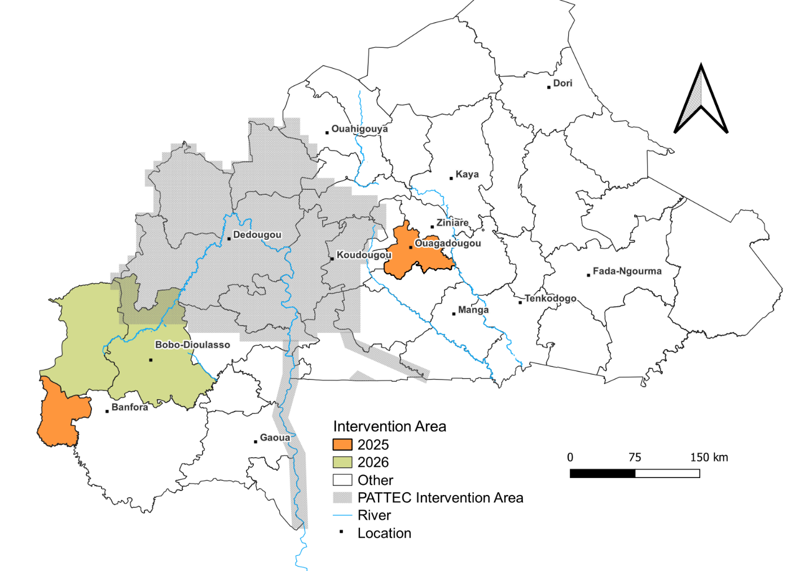
Mobilization of financial ressources
Development of 2 proposal projects:
- AIEA (2026-2029), extra budget
- FAO national, TCP (2026-2028)
Tsetse and trypanosomiasis control and elimination activities undertaken in 2023-2025
Implementation of the national strategy
2025: Leraba and Kadiogo provinces: Government budget

Slide 6
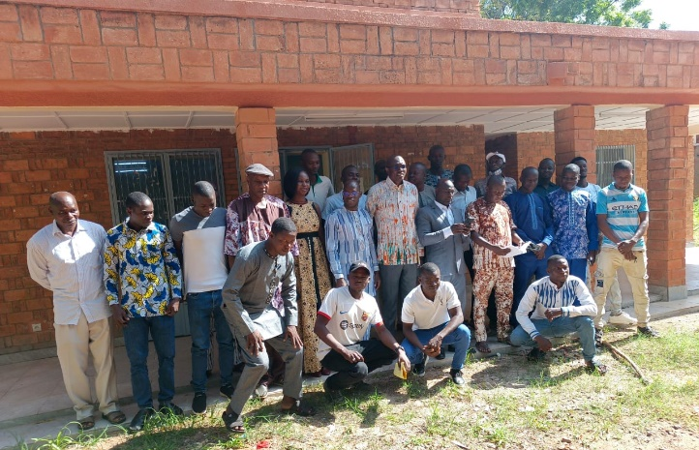
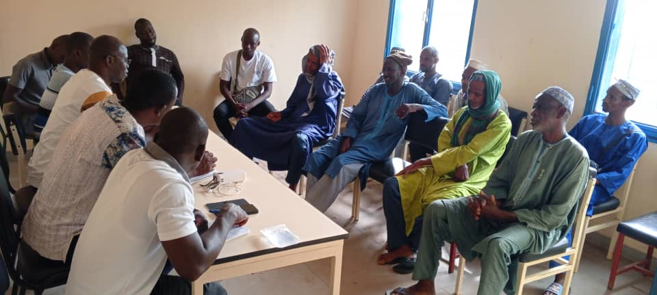
Implementation of the national strategy in the Leraba province
Leraba province: 8 rural municipalities
Entomological survey
Training of field technicians
 | March 2025 |  | June 2025
Nb trap | Nb flies | ADP Gpg | Nb trap | Nb flies | ADP Gpg
56 | 107 | 1,0 | 60 | 137 | 1,1
Parasitological survey
Beneficiary awareness
March 2025 |  |  | June 2025
Nb cattle | Prevalence (%) |  | Nb cattle | Prevalence (%)
 | Tc | Tv |  | Tc | Tv
377 | 8.5 | 1.1 | 360 | 3.1 | 0.3

Slide 7
Implementation of the national strategy in the Leraba province
Kadiogo province: FASO Kosam dairy farms, July – August 2025
 | Entomological survey |  |  | Paragitological survey
Locality | Nb trap | DAP Gpg | Meca vect | Sample | AAT prevalence (%)
Banakeledaga | 8 | 0,1 | 0,8 | - | -
Saaba | 4 | 0,0 | 0,3 | 20 | 0,0
Loumbila | 4 | 0,0 | 0,4 | 20 | 5,0
Zagtouli | 8 | 0,0 | 0,1 | 40 | 2,5
Koubri | 2 | 0,0 | 0,0 | 41 | 2,4
Komsilga | 7 | 0,0 | 0,0 | 30 | 0,0
Samendeni | 8 | 0,0 | 0,8 | - | -
Total | 41 | 0,01 | 0,4 | 151 | 2,0

Slide 8
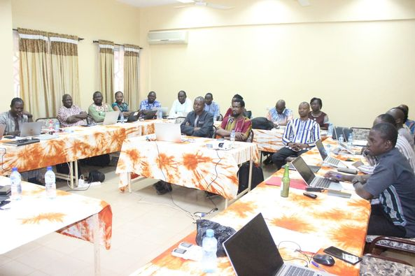
Tsetse and trypanosomiasis control and elimination activities undertaken in 2023-2025
Technical support to the Minister of Human Health
Development of the dossier for eliminating HAT gambiense as a public health problem in Burkina Faso
Development of the dossier for verification of the cessation of transmission of HAT in Burkina Faso

Slide 9
Collaborations and partnerships for T&T control and elimination activities undertaken in 2023-2025
Partners/stakeholders and activities
  IAEA: training / control and tsetse rearing material
  Project COMBAT: field data collection and strategy development
  FAO: technical support on Atlas and PCP mapping development
  CIRDES: technical support
  Decentralized technical services: support for parasitological and entomological surveys
  Beneficiaries: for deploying screens and spraying insecticide
Crossborder/regional activities
  Support of Senegal eradication project in sterile males
  Joint FAO/IAEA – RAF5087: regional capacity building in terms of human and material resources

Slide 10
Challenges and how they are being resolved
Constraints for field activities due to insecurity
Adapatation of protocols and dispositifs:
  Training of technicians in inaccessible areas and provision of minimum equipment for collecting parasitological and entomological data
  Deployment of impregnated screens by beneficiaries
Insufficient financial resources
Appeal to the Minister who increased the allocated budget
Integration of T&T into the overall animal health program, which provides support :
  From field technicians for data collection and implementation
  From existing projects, e.g., in developing strategy and acquiring control equipment

Slide 11

Way forward and planned T&T control and elimination activities for 2025-2027
Finalization and publication of the update ATLAS and PCP mapping for AAT
Domesticate new tsetse species (Gt: AIEA-CIRDES) and mass-rear sterile males to support West Africa campaigns
Mobilization of financial resources
Continued implementation of the national strategy
Province | 2025 | 2026 | 2027
Leraba + Kadiogo
Kenedegou+ Houet

Slide 12


