Slide 1


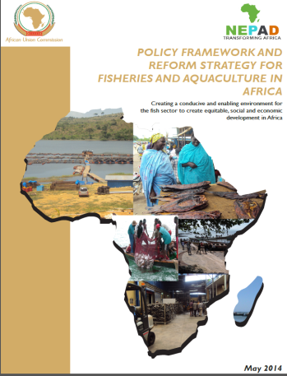
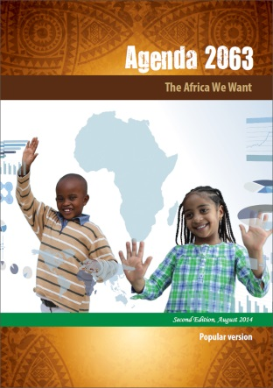

Blue Economy Sectors and Linkages for Blue
Economy Development in COMESA region
Dr. Sloans Chimatiro
President
Pan-African Policy Research Network for Fisheries & Aquaculture in Africa
27 April 2022
Lusaka, Zambia

Slide 2
Marine and Freshwater Domain of COMESA Region
The linkages between Blue Economy Sectors & its development in COMESA region is determined by the marine and freshwater domain of the region
The marine & freshwater domain comprises the following ecosystems:
Indian & Atlantic Oceans & Red Sea,
Marine & freshwater Islands,
Estuaries & deltas,
Lagoons (marine & freshwater),
Wetlands, rivers & floodplains,
Mangrove forests & marsh/sea grass,
Coral reefs,
Coastal & shoreline beaches and dunes,
Marine shipping lanes & inland waterways, and
Dams & reservoirs (hydro-electricity, municipal water, irrigation).

Slide 3
The COMESA Context of Blue Economy & State Implementation
The COMESA Treaty implicitly enshrines the concept of the blue economy in its various Articles & Provisions.
COMESA Industrial Strategy 2017-2026 & MTSP 2021-2025 have adopted a clear definition of the blue/ocean economy
While these plans & programmes have “envisioned the transformation by unlocking investments and the generation of jobs to citizens through rebranding the use of the water bodies to realize the potential for economic advancement and tapping into new areas of economic actions”
“However, its implementation was largely unsuccessful due to the absence of institutional arrangements for coordination at the COMESA Secretariat and in the Member States and limited requisite resources” (Dr. Hamukuaya 2022, draft BE Strategy)

Slide 4
What Could be the Missing Links?
Absence of coordinating institutions – to pull unrelated economic components into a coherent whole
We might have adopted a seemingly attractive, but complex concept – “Blue Economy”
Therefore, we might need to start from what we know best – fisheries and aquaculture
Recall: COMESA 4th Joint Ministers of Agriculture, Environment and Natural Resources held in Ezulwini, eSwatini on 21 – 22 July 2011, acknowledged the importance of the marine and freshwater domain of the region, and adopted the COMESA Fisheries & Aquaculture Strategy.

Slide 5
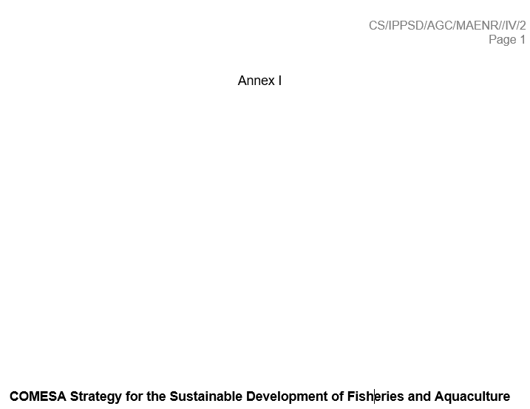
Desired Future Outcomes of COMESA Fisheries & Aquaculture Strategy
Coherent, coordinated approach is agreed, stake-holders committed to implementation, and investors are aware of options and opportunities in public, private and other sectors.
Regional, national & local capacities for management & development strengthened.
Best practice management defined, with key stocks & resources identified for development of management plans.
Priority zones & targets for aquaculture development identified & investment strategy in place for public & private sector
Value chain approach to sector development adopted and targets and investment strategies identified;
Awareness of development impact of fish at all levels; sectoral options for addressing equity, potential links with MDGs; potential food security impact understood; agreements to develop and apply targeted approaches; recognition of linkages with other sectors
Framework & processes in place for defining change, monitoring indicators, building and exchanging knowledge; parameters for ICT, knowledge links, decision-making, accountability

Slide 6
Strategy to Transition COMESA to Blue Economy
In order to transition COMESA Member States to Blue Economy, we need to:
Build a coherent Blue Economy Strategic Framework,
COMESA MS should harness the ocean and inland waters by pull together existing/traditional sectoral development themes.
COMESA MS should Implement policies and strategies targeting the key economic inter-sectoral coordination to harness Blue Growth of BE.

Slide 7
Blue Economy Sectors and Linkages for Blue
Economy Development Strategy
COMESA Blue Economy Development Action | COMESA Fisheries & Aquaculture Strategy Specific Outcomes
Promote adoption of Blue Economy and institutionalise at regional and national levels | Coherent, coordinated approach is agreed, stake-holders committed to implementation, and investors are aware of options and opportunities in public, private and other sectors.
Mainstream Blue Economy into national development planning process
Undertake stocktaking to value Blue Economies or components | Value chain approach to sector development adopted and targets and investment strategies identified
Promote establishment of Blue Economy Agencies or Directorate, under Ministerial or Cabinet Decree
Assessment of COMESA Secretariat & capacities to develop and/or implement the Regional Strategy on BE | Regional, national & local capacities for management & development strengthened
Take stock of available skills and undertake skills development
Develop Blue Economy curriculum at National Training Centres (draw lessons from Best Practices)
Design and implement BE governance and institutional reforms
Develop a regulatory framework for Blue Economy | Best practice management defined, with key stocks & resources identified for development of management plans.
Create awareness about the wealth-generation potential of Blue Economy at regional and national levels | Awareness of development impact of fish; address equity, links to MDGs; food security; linkages with other sectors
Establish a mechanism for Blue Economy Finance (e.g. Blue Bonds)
Mobilise & direct grants for Blue Economy projects to non-state actors and private sector
 | Priority zones & targets for aquaculture development identified & investment strategy in place for public & private sector
Draw & scale-up lessons from Seychelles Debt-for-Nature Swap (DNS)
Develop & harmonised Blue Economy indicators as well as M&E Framework | Framework & processes in place for defining change, monitoring indicators, building and exchanging knowledge; parameters for ICT, knowledge links, decision-making, accountability
Develop & internalise COMESA Blue Economy Satellite Accounts (BESA)

Slide 8
Next Steps
Strengthen capacity among public sector officials to plan coherently for Blue Growth
Allocate and mobilise funding to implement investible priorities
Ensure political will by MS to align their national policies and strategies with the COMESA Blue Economy Strategy
A proper national accounting system should be set-up to centrally record annual changes of Blue Economy sectors and ecological components (AU-IBAR 2019 – Africa BE Strategy).
Set clear goals, vision, purpose, strategic objectives & outcomes,
The goals, purpose, objectives & outcomes must be aligned with African Union’s Agenda 2063 (6 BE priorities), AU BE Strategy (2019); and other global commitments (SDGs; UNCLOS, UN Decade of Ocean Science etc)

Slide 9
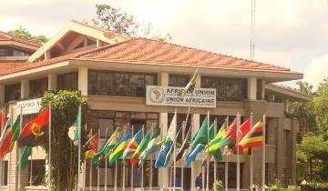
Thank You
AU-IBAR: Providing leadership in the development of animal resources for Africa

